Slide 1
Marker Gene Selection with ARI Method

Slide 2
We worked with ”melanoma” dataset.
Since we know and use the true cells types, this is a supervised method.
Notice that we first removed the cells with unknown cell type, and the remaining dimension is: (23686 genes, 4139 cells)

Slide 3
Basic Idea
For each gene, divide its expressions levels into several clusters. Then use this calculated clustering and the true clustering to assign an ARI value to each gene:
ARI(calculated clustering, true clustering)
Now that we have an ARI value for each gene, we rank them and choose the genes associated with the largest 902 ARI values as the markers (902 is to be consistent with the number of markers selected by SC Marker for fair comparison)
Then we use “Seurat” package to cluster cells based on the markers selected (by SC Marker and by our method). We compare the results using ARI as the metrics:
ARI for SC Marker: 0.37249
ARI for our method: (to be discussed later)

Slide 4
How do we divide expression levels of each gene into several clusters?

Slide 5
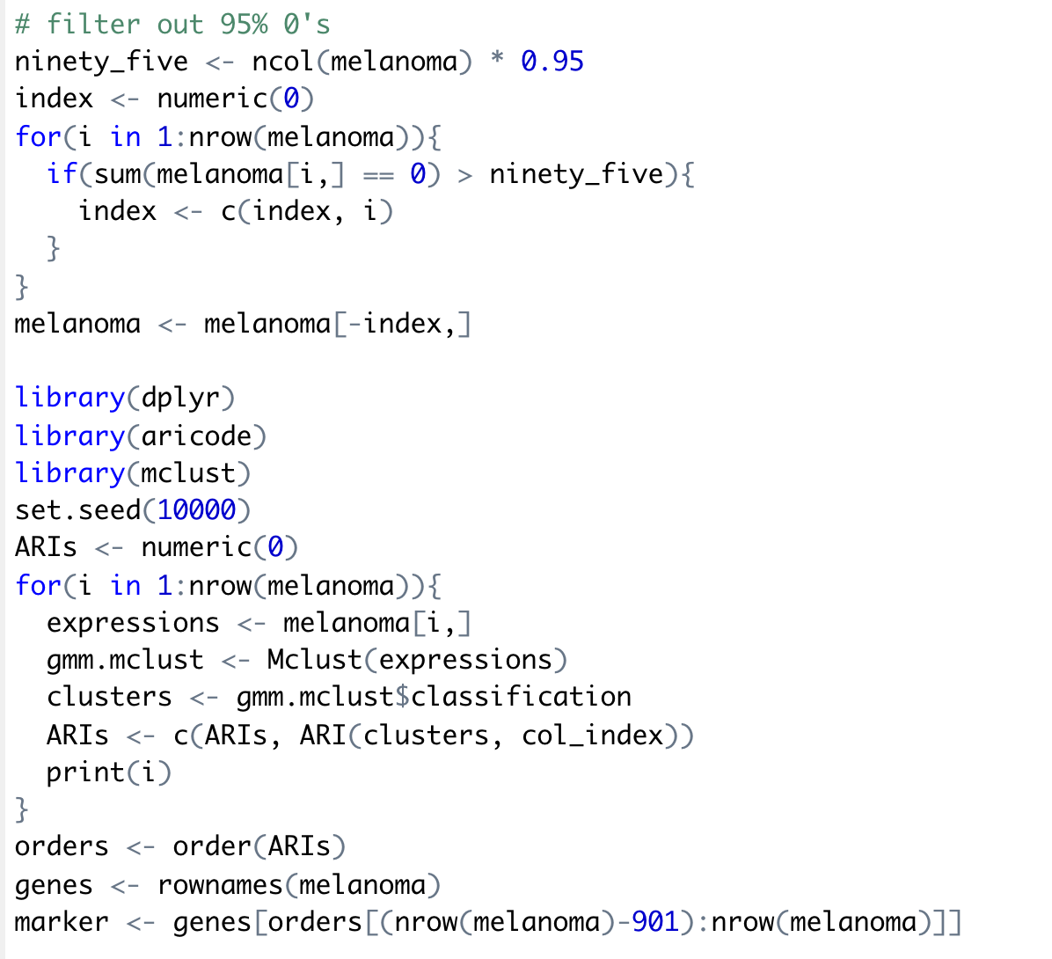
Method 1
For each gene, we applied the parameterized finite Gaussian mixture model to its expression levels to form a clustering. (This is implemented with ‘mclust’ package in R)
Since fitting the Gaussian mixture model is slow, we first removed genes whose expression level is 0 in more than 95% cells. The remaining dimension is: (13315 genes, 4139 cells)
Resulted ARI = 0.4262677

Slide 6
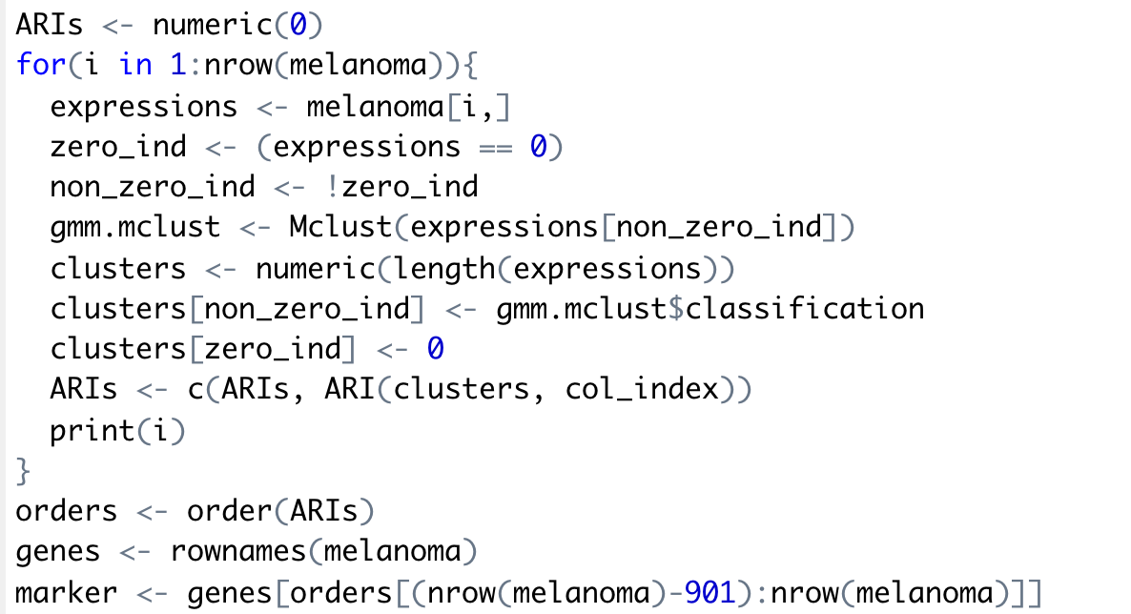
Method 2
Motivation: Since the melanoma dataset has high sparsity, we decide to put cells whose expression level is 0 into 1 cluster and cluster the remaining cells with gaussian mixture model.
Resulted ARI = 0.3606822
This result is actually worse than that of SC Marker.

Slide 7
In the previous 2 methods, we let the ‘mclust’ function itself decide the number of gaussian models to fit.
Then we tried adjusting the number of gaussian models to fit on our own, but didn’t get a better result.
By fitting gaussian mixture model, we didn’t get a much better result than SC Marker. We inferred the the reason to be that it might not fit the model assumption well.

Slide 8
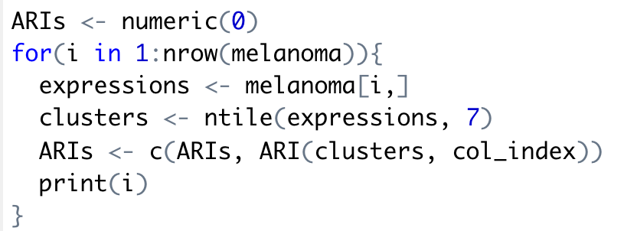
Method 3
For each gene, we split its expression levels into clusters based on the quantiles. i.e. we put cells whose expression levels are in the same quantile range into one cluster.
It’s implemented with ‘ntile()’ function in R.
Since ntile() function is much faster than Mclust() function, we kept all the genes.
We first tried splitting into 7 clusters, because there are 7 cell types in true labeling.
Resulted ARI = 0.3795651

Slide 9
Since this result is still no better than SC Marker’s, we adjusted the number of clusters split into. We tried number of clusters = 7,6,5,4,3,2. And we want to see if there’s any relation between the number of clusters and the resulted ARI.
Unluckily, there’s no clear pattern as indicated in the table above, because the resulted ARI fluctuates as the number of clusters decreases.
Notice that number of clusters is 5, the resulted ARI is relatively high (0.4410636). However, we can’t find any plausible explanation for it so that might just be a coincidence.
Number of clusters split into | Resulted ARI
7 | 0.3795651
6 | 0.3586774
5 | 0.4410636
4 | 0.4240791
3 | 0.4065269
2 | 0.3450305

Slide 10
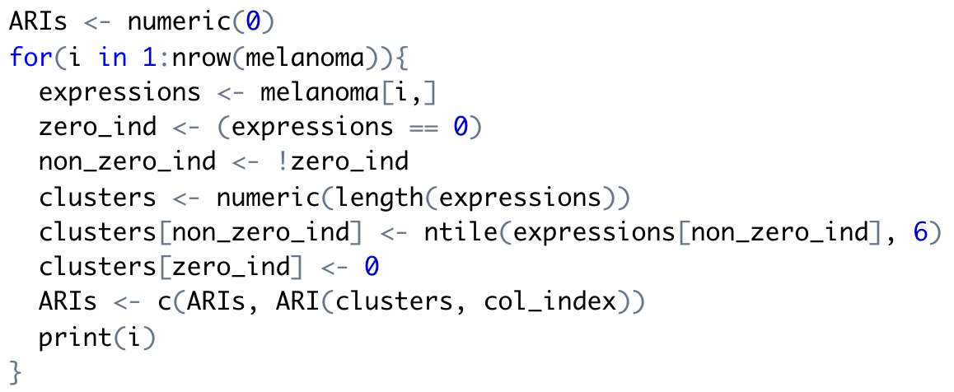
Method 4
Again, due to the high sparsity of melanoma dataset, we put cells whose expression level is 0 into 1 cluster and cluster the remaining cells based on the quantiles.
We first split the remaining cells into 6 clusters, so that there are 7 clusters in total (one cluster is composed of all 0’s)
Resulted ARI = 0.3874056

Slide 11
Again, we tried adjusting the number of clusters split into when doing ntile(). We tried number of clusters = 6,5,4,3,2,1 (with the actual number of clusters = 7,6,5,4,3,2 because of the additional cluster full of 0’s)
Number of clusters split into | Resulted ARI
7 | 0.3874056
6 | 0.3914178
5 | 0.3925514
4 | 0.3907454
3 | 0.3994951
2 | 0.3908529
We can see that the resulted ARI remains almost the same when number of clusters decreases. We inferred the
reason to be that the high sparsity of melanoma dataset makes the cluster full of 0’s have a dominating effect.

Slide 12
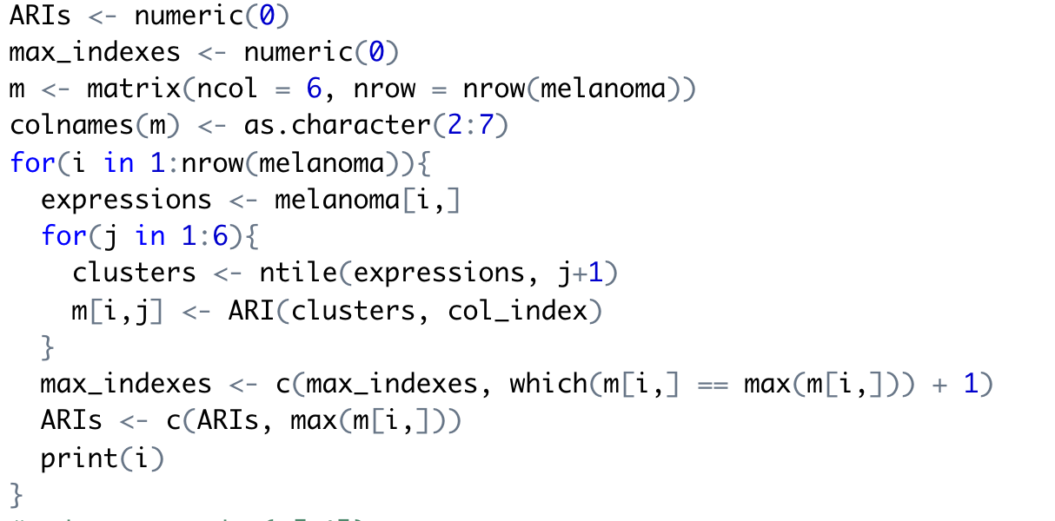
Method 5
Motivation: Different genes can separate different cell types. For example, a gene may be able to separate T-Cells and B-Cells, while another gene may be able to separate malignant cells, Endothelial cells and Macrophages. Thus, it’s not intuitive to choose the same number of clusters for all genes and do the comparison.
In this method, we tried different numbers of clusters (2-7) for each gene, so for each gene we can get 6 ARI values and we select the highest one as the ARI value for that gene. Then we can use the genes with top 902 ARIs values as the markers.
Resulted ARI = 0.388936

Slide 13
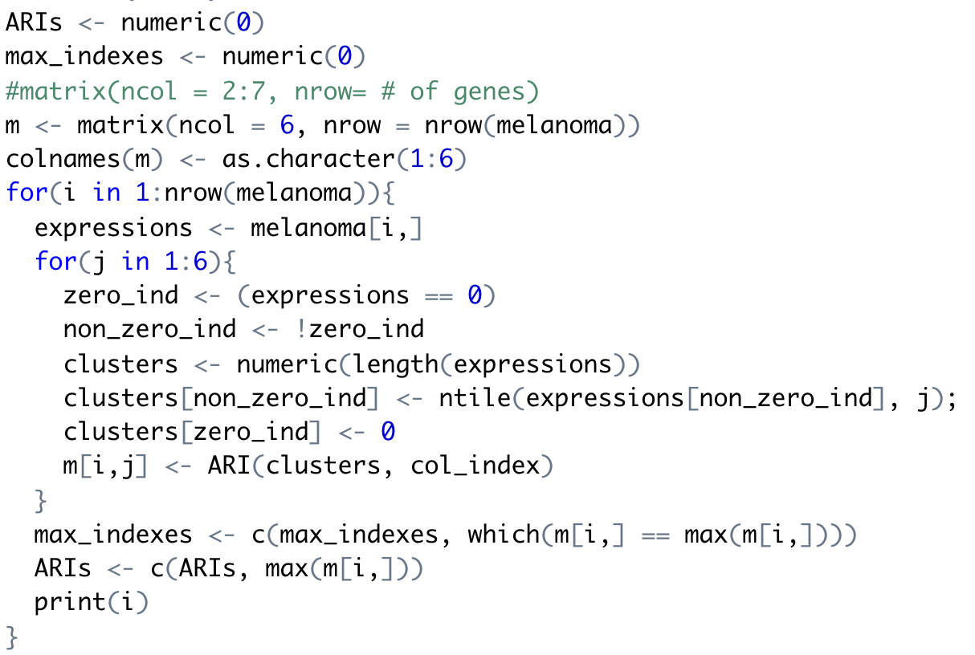
Method 6
Similar to Method 5.
Here, we tried putting 0’s into one cluster when performing clustering based on the expression levels of each gene.
Resulted ARI = 0.4561111
This is the highest ARI we have achieved so far,
and it’s interpretable.

Slide 14
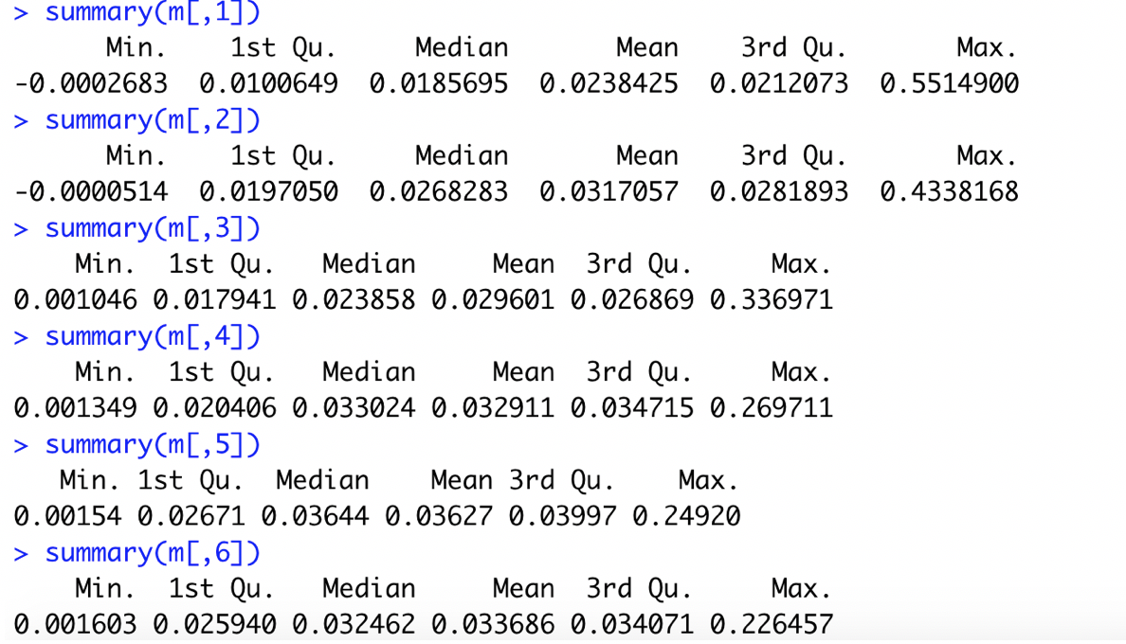
Method 7
In Method 5, we got 6 ARI values for each gene, each value corresponds to a different number of clusters (2-7). So we got a matrix that looks like:
Then we looked into the summary of each column:
 | 2 clusters | 3 clusters | 4 clusters | 5 clusters | 6 clusters | 7 clusters
ARI for gene1
ARI for gene2
We observed that:
When the number of clusters increases, the max of all
genes’ ARIs decreases.

Slide 15
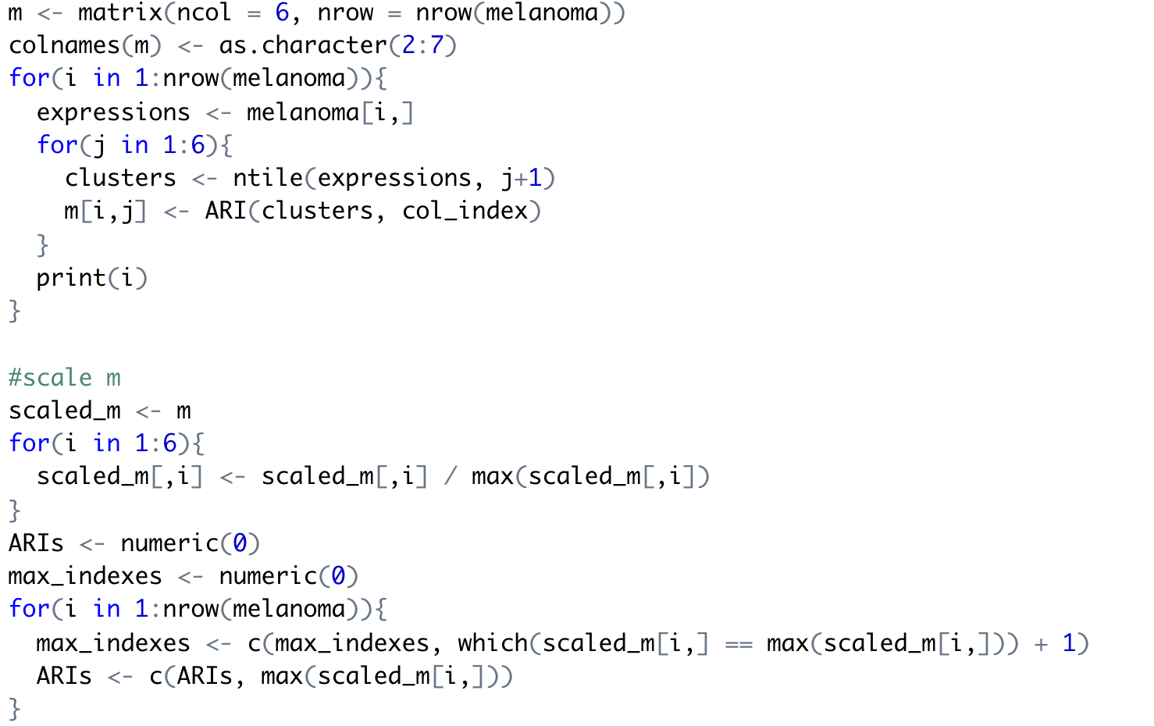
Intuitively, we would want each marker gene to separate as many cell types as possible, so we want to give genes that can separate more cell types an advantage. We observed that the max ARI value decreases as the number of clusters decreases, so the genes that can separate less cell types actually have an advantage. Therefore, we took away that advantage by normalizing each column by its max value.
Then we performed a similar procedure as Method 5 by selecting the highest ARI value as the ARI value for each gene, then select the top 902 genes.
Resulted ARI = 0.4250419

Slide 16
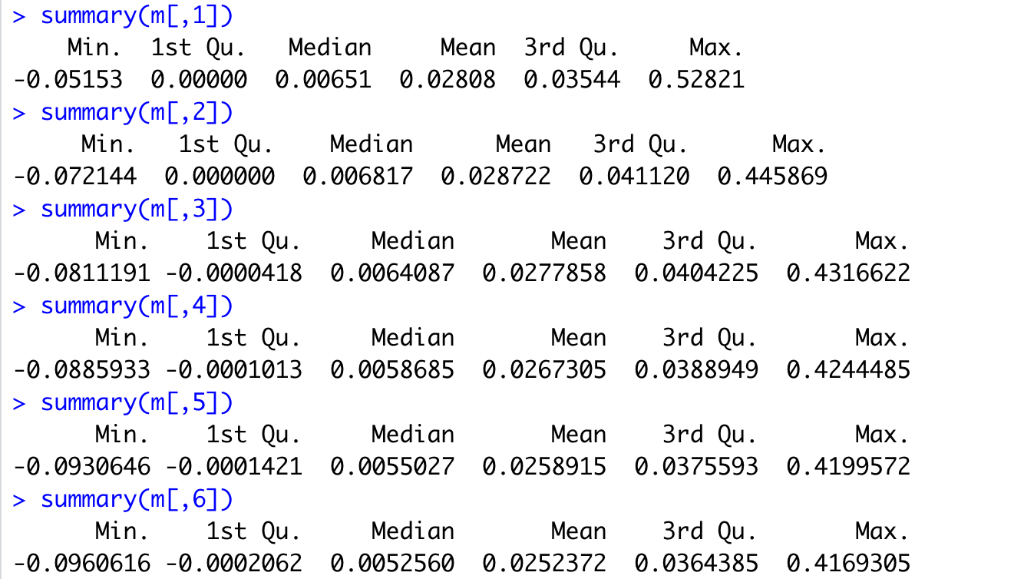
Method 8
Similar to Method 7
Here, we tried putting 0’s into one cluster when performing clustering based on the expression levels of each gene.
Looking into the summary of each column:
Again, we found that:
When the number of clusters increases, the max of all genes’ ARIs decreases.
Therefore, we can perform normalization on each column by its max value as before.
Resulted ARI = 0.4436033
This result also looks good.

Slide 17
Method 9
Motivation: This is a supervised method, so we want to utilize the known cell type information as much as possible. Therefore, we no longer divide the expression levels into same-sized clusters. Instead, we divide them into different-sized clusters whose sizes are determined by the sizes of true cell clusters.
There are 4139 cells in total and 7 cell types, and the size for each cell type cluster is: 2064, 515, 125, 65, 61, 52, 1257.
So when we perform clustering based on the expression levels of each gene, we split into 7 clusters with sizes indicated above.
However, one question is that: how do we order the clusters?
E.g. (2064, 515, 125, 65, 61, 52, 1257) OR (515, 2064, 1257, 65, 61, 52, 125) ?

Slide 18
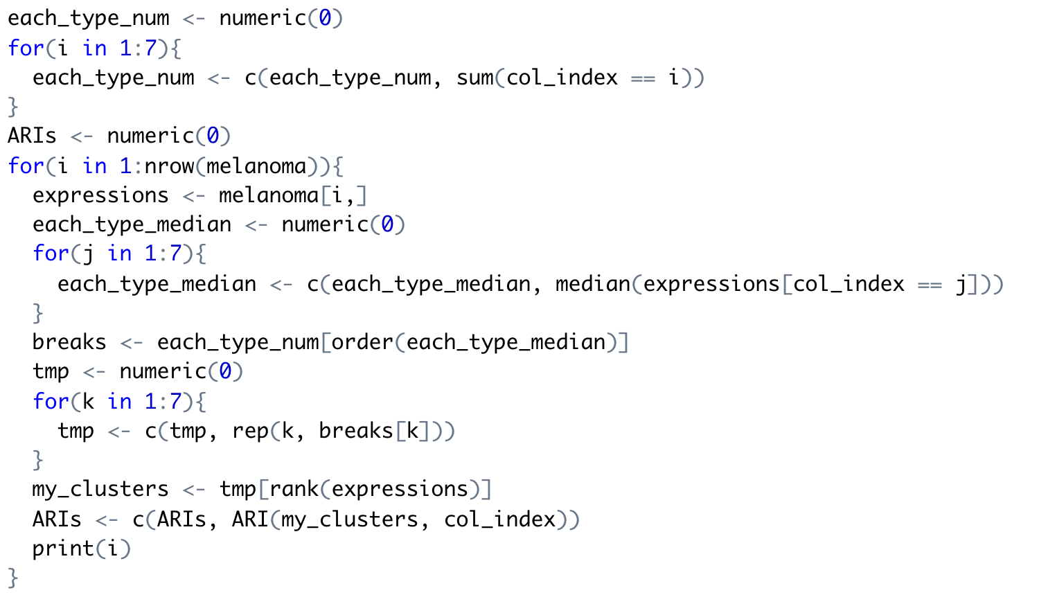
Solution: For each gene, we calculated the max expression level for each cell cluster and used it as a metric to order the clusters. (We didn’t use the mean/median as a metric because the high sparsity of the dataset may make the mean/median to be 0)
An example:
Suppose the order of clusters for one gene looks like: (515, 2064, 1257, 65, 61, 52, 125). Then we order the expression levels and take the first 515 into the first cluster, the next 2064 into the second cluster, the next 1257 into the third cluster, and so on.
Resulted ARI = 0.3809749
Not much improvement. We inferred the
reason to be that not all genes can separate
all the 7 cell types, so it may not be advisable
to make the number of clusters to be 7 for all
genes.

Slide 19
Conclusion
The result of Method 6 is the best (ARI = 0.4561111).
The result of Method 8 is also comparable (ARI = 0.4436033).
Both methods put 0’s into one group when performing clustering based on each gene’s expression levels. Thus, taking into account of the sparsity of melanoma dataset is necessary.
Compared to the ARI achieved by SC Marker: 0.37249, our method has made some improvement. However, as a supervised method, the improvement may be not so significant.

Slide 20
Future steps
Test on some other datasets, such as the HNSCC dataset, to see if the result is consistent.
Try some other clustering algorithm on the marker genes, such as K-means.

